Slide 1
ESG Factor Exposure in Asset Pricing Model
Fuqua Capstone Project
James Chung, Saiganesh Musthyala, Cynthia Xu, Liyang Wu, Sava Kholin

Slide 2





Team
James Chung
Cynthia Xu
Liyang Wu
Saiganesh Musthyala
Sava Kholin

Slide 3
Agenda
Problem Statement
Executive Summary
Conceptual Framework
Data Source
Exploratory Data Analysis
Data Modelling
Output Comparisons
Next Steps and Applications
Appendix

Slide 4
Problem Statement

Slide 5

Asset Pricing Model (Fama-French)
Asset Pricing model is used for determining the required or expected return of an asset
Three-factor model estimates and explains an investment’s return based on market risk, market size and investment value
Excess Return ~ market + company size + value
Market risk: excess return of the market portfolio
Size risk: excess return of the high market cap companies
Value risk: excess return of the high book-to-market
ratio companies
Eugene Fama at the Royal Swedish Academy of Sciences
Notes:
General idea of what is asset pricing model and Fama-French 3-factor model we used. Provides the audience with some background information to understand the topic.

Slide 6
Environment, Social, Governance (ESG)
Environment | Social |  | Governance
Environmental Footprint Climate change, GHG emissions, and global pollution Local pollution Impacts on landscapes, ecosystems, and biodiversity Overuse and wasting of resources Animal mistreatment | Community Relations Human rights abuses and corporate complicity Impacts on communities Local participation issues Social discrimination | Employee Relations Forced labor Child labor Freedom of association and collective bargaining Discrimination in employment Occupational health and safety issues Poor employment conditions | Corporate Governance Corruption, bribery, extortion, money laundering Executive compensation issues Misleading communication Fraud Tax evasion Tax optimization Anti-competitive practices

Slide 7
Problem Statement
Question
Approach
Determine whether or not outperformance of a portfolio can be explained by ESG rating.
If so, how much can ESG rating explain and can we construct a portfolio leveraging this?
To estimate ESG exposure as a factor in Asset Pricing model by expanding the Fama French 3-factor model:
Evaluate EGMB factor (ESG Good Minus Bad returns) for different financial markets
Estimate and compare the significance of the ESG risk factor in the regression across different financial markets (US market vs European market)

Slide 8
Executive Summary

Slide 9
Executive Summary
Factor exposure of ESG is more significant in European market compared to US market.
The significance of factor exposure of ESG increases steadily over time and is greater for certain portfolios.
Most companies with extreme returns had high ESG rating, but this could be attributed to the imbalance in the data.
A
B
C

Slide 10
Limitations
RepRisk's ESG rating needs greater granularity and more study to be put to better use:
RepRisk rating needs to be more detailed and sensitive, as the current dataset is imbalanced with low variance. The imbalanced dataset is heavily centered around its arithmetic mode, contributing to insignificant factors.
The refined EGMB factor can be further used to create an investment strategy and portfolio

Slide 11
Conceptual Framework

Slide 12
Fama-French Three-Factor Model
R_{i} − R_{f} = α_{i} + β₁(R_{M} − R_{f}) + β₂SMB + β₃HML + ϵ_{i}
where:
R_{i} = total return of the portfolio i
R_{f} = risk free rate of return
R_{M} = total market return
SMB = size premium (small cap minus big cap)
HML = value premium (growth minus value)
β_{1,2,3} = factor coefficients
ϵ_{i} = error
Notes:
Besides the systematic market risk being captured in the original Capital Asset Pricing model (CAPM) model, Fama and French recognize some variation and patterns in average stock returns: small market-cap companies tends to overperform big market-cap companies; value companies tends to overperform growth companies.
They tried to use factors in time series regression to explain these patterns in the stock return variation.
The 2 anomalies captured by Fama and French are size factor and value factors.

Slide 13
New Four-factor Model
R_{i} − R_{f} = α_{i} + β₁(R_{M} − R_{f}) + β₂SMB + β₃HML + β₄EGMB + ϵ_{i}
where:
R_{i} = total return of the portfolio i
R_{f} = risk free rate of return
R_{M} = total market return
SMB = size premium (small cap minus big cap)
HML = value premium (value minus growth)
EGMB = ESG premium (good ESG minus bad ESG)
β_{1,2,3,4} = factor coefficients
ϵ_{i} = error
Notes:
Expanding the Fama French three-factor model by adding a new independent variable EGMB. EGMB stands for the monthly return of good ESG performance company minus bad ESG performance company. We want to use this factor to understand if there exists the ESG anomalies.

Slide 14
What data do we need
Companies' ESG performance / Exposure to ESG risks (ESG rating)
Companies' monthly return to calculate the ESG risk premium
Portfolio return (based on size and operating profits)

Slide 15
Data Source

Slide 16
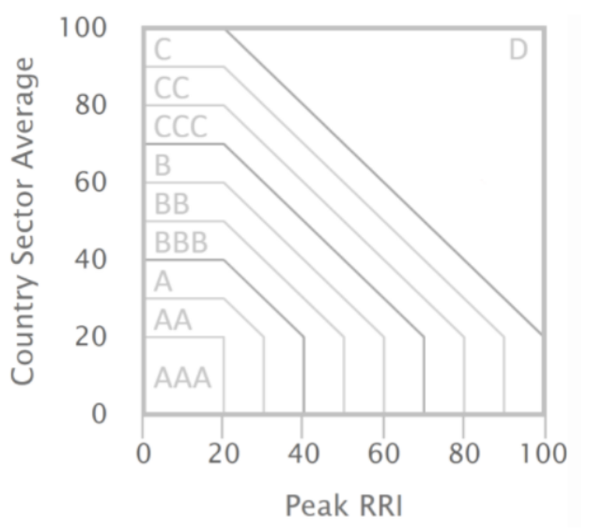
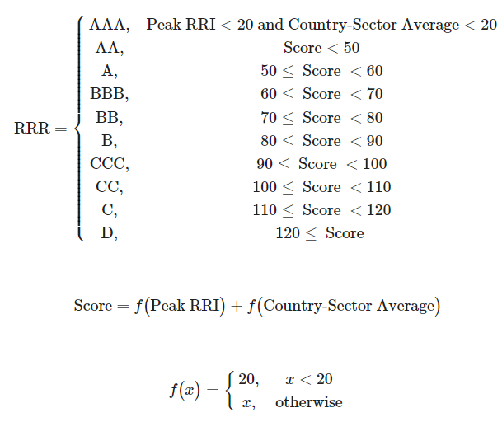
RepRisk Rating
More details on ratings methodology available on:
https://www.reprisk.com/lab/reprisk_rating.html
https://www.reprisk.com/lab/jn/esg-score.html
Notes:
The reprisk database is one of the most effective database for ESG ratings. It includes a comprehensive research scope of 28 research issues covered under the international standards.
The reprisk rating (RRR) is a very important metrics we used to quantify companies' ESG performance. It combines 2 factors: the peak reprisk index that based on the company's linked risk incidents and the country-sector average that taking into account the sectors and locations of the company

Slide 17
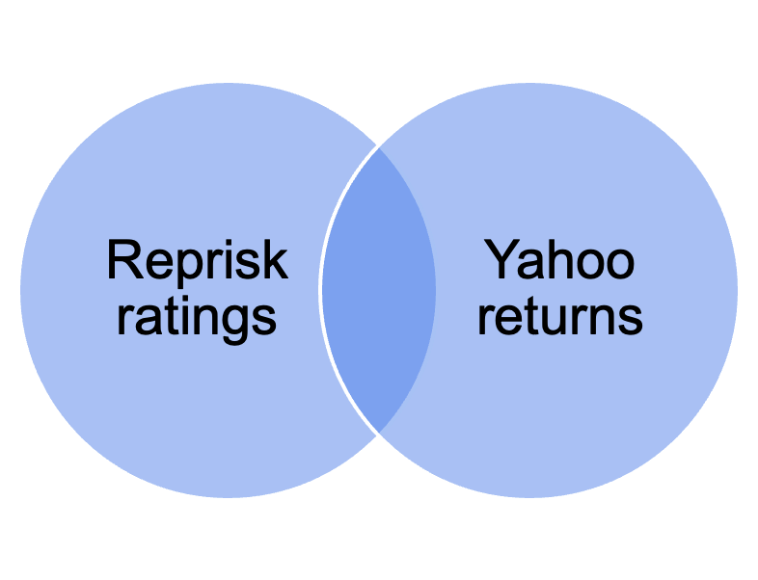
Data Source
RepRisk database with companies' ESG score (data ranging from 2010 to 2020)
Yahoo Finance for historic monthly returns
Ken French database to get the portfolio excess return for SMB and HML factor for different markets
Ticker
symbol

Slide 18
Exploratory Data Analysis

Slide 19
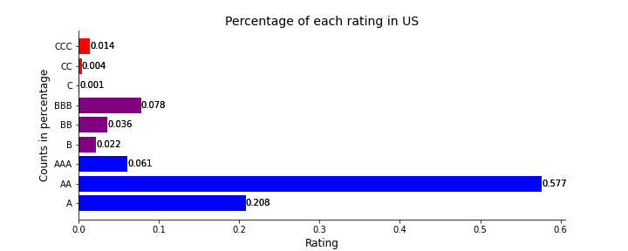
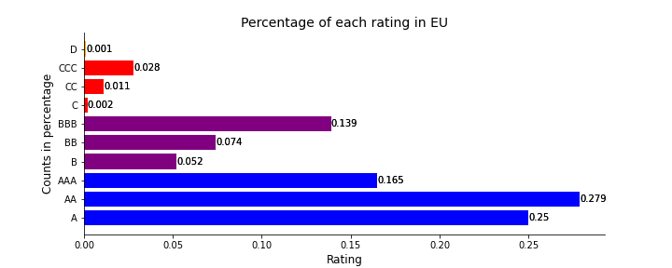
Distribution of ESG Index in U.S. & EU from 2010 to 2020
“AA” are the greatest in both market
US has more companies rating in A-level (A,AA,AAA)
EU has more companies rating in B-level (B,BB,BBB)
Notes:
Compared the distribution of ESG index between U.S. and Europe.

Slide 20
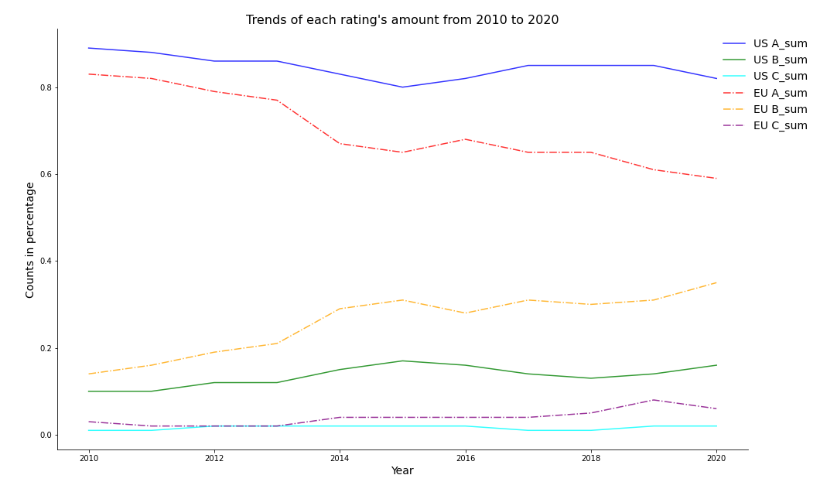
A-level rating companies are dominant in the dataset
U.S. A-level rating occupies the greatest part (over 80% each year)
EU high ESG index companies is decreasing
Although 'A' rated companies remain dominant, such dominance is much weaker in the EU market than in the US market.
Notes:
Trends of cumulative ratings (level A,B,C,D) for both U.S. and Europe over the 10-year period

Slide 21
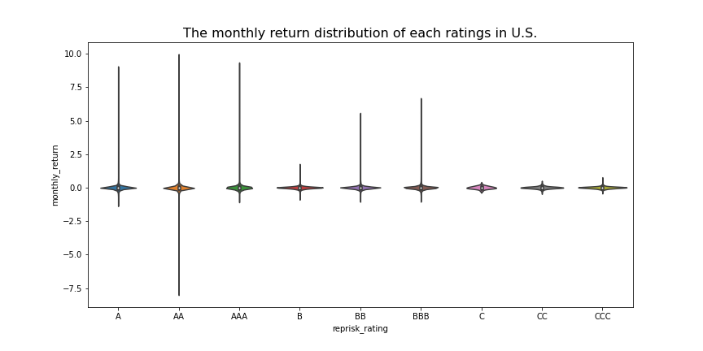
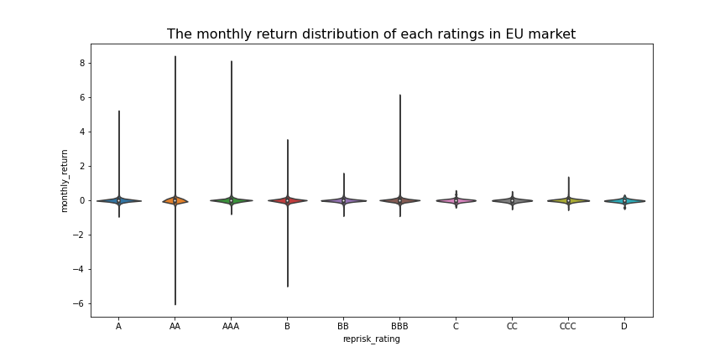
Market Monthly Return Distribution U.S. & EU
C
Both companies with higher ratings have higher peaks of returns, especially for rating AA.​
Notes:
Monthly return distribution in U.S. and Europe, higher ratings company have higher perks of returns.
However, some data problem in here is that the large range for monthly return, like "AA", which also have high negative returns

Slide 22
Current RepRisk Index (Current RRI)
The Current RRI denotes the current level of media and stakeholder attention of a company related to ESG issues.
The RRI ranges from zero (lowest) to 100 (highest). The higher the value, the higher the risk exposure:
0-25 = low risk exposure
26-49 = medium risk exposure
50-59 = high risk exposure
60-74 = very high risk exposure
75-100 = extremely high risk exposure
Notes:
Definition of the Current RRI

Slide 23
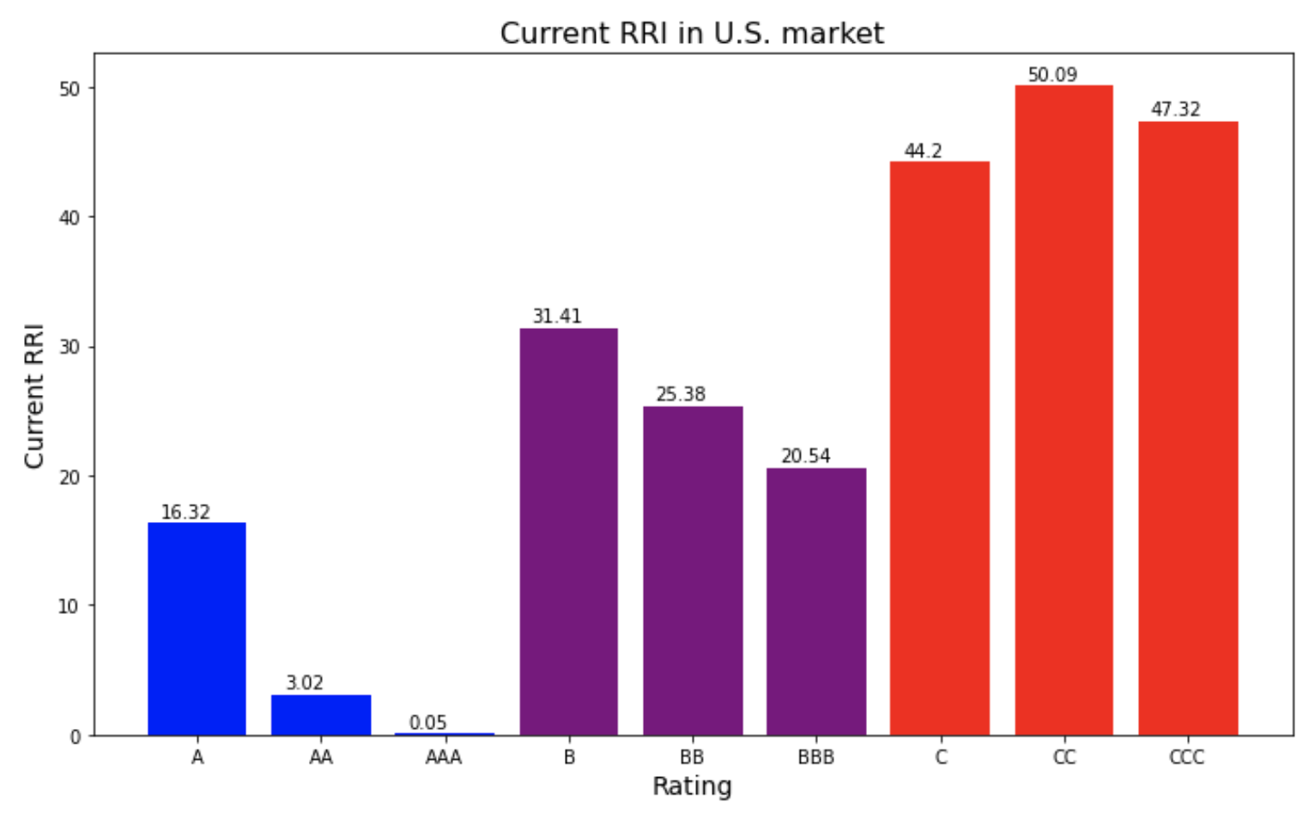
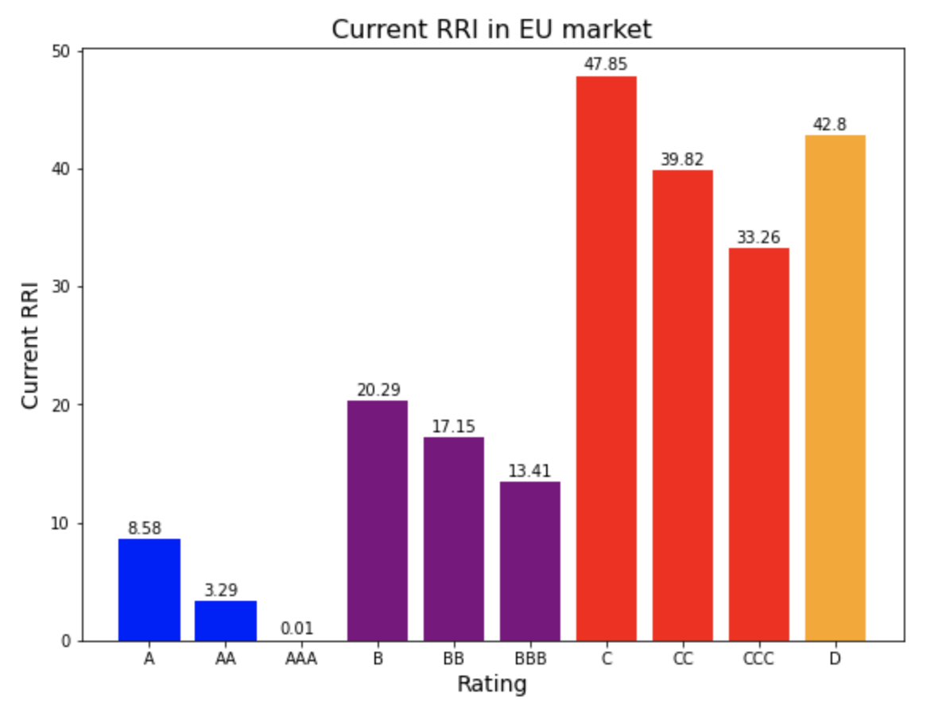
Each Rating Current RRI in U.S. & EU
Both markets show higher rating level have less C-RRI
For each rating level, C-RRI in EU companies are slightly lower than U.S. companies
C-RRI in EU for ”C” is higher than “D”
Notes:
Compared the Current RRI for each rating (AAA, AA, A, BBB, BB, B, CCC, CC, C, D) between the U.S. market and Europe market in 2010 to 2020

Slide 24
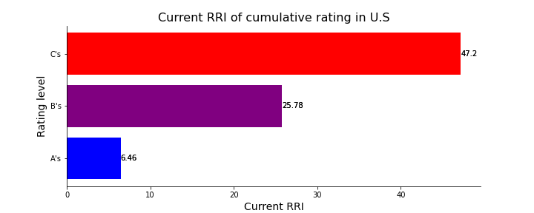
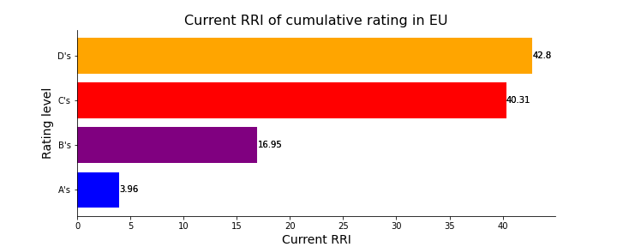
Cumulative Rating Current RRI in U.S. & EU
C-RRI of cumulative rating has the same conclusion as each rating one
Notes:
Cumulative rating for Current RRI, which also demonstrate our former conclusion in each rating one

Slide 25
Country-Sector Average
The Country-Sector Average of the company is calculated by
The Headquarters ESG Risk Exposure value (weighted 50%)
The Country-Sector value of the company's country of headquarters and primary sector
The International ESG Risk Exposure value (weighted 50%)
The average of all Country-Sector values of the country-sector combinations where the company has been linked to ESG risk incidents
Notes:
Country-Sector Average Definition:
The Country-Sector value of the company's country of headquarters and primary sector
The average of all Country-Sector values of the country-sector combinations where the company has been linked to ESG risk incidents

Slide 26
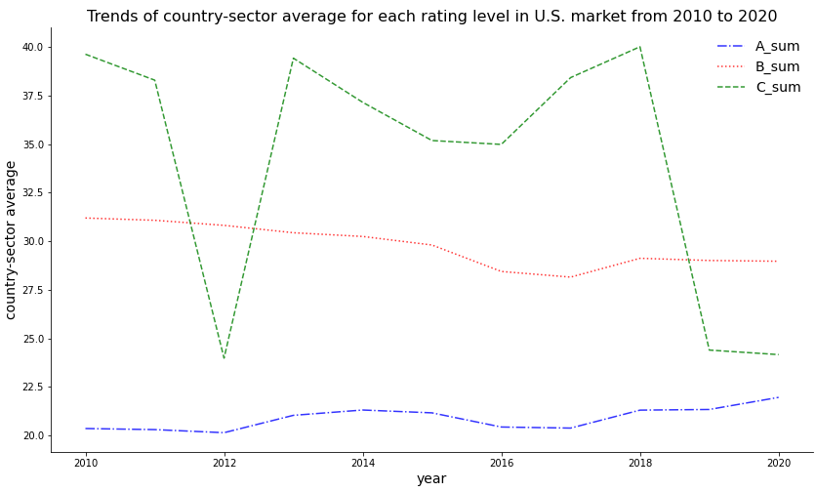
U.S. Market Country-sector Average Trend
Higher rating level with lower country-sector average
A level rating changed slightly
C level rating have dramatic increase and decrease
Notes:
U.S. Country-sector Average trend from 2010 to 2020

Slide 27
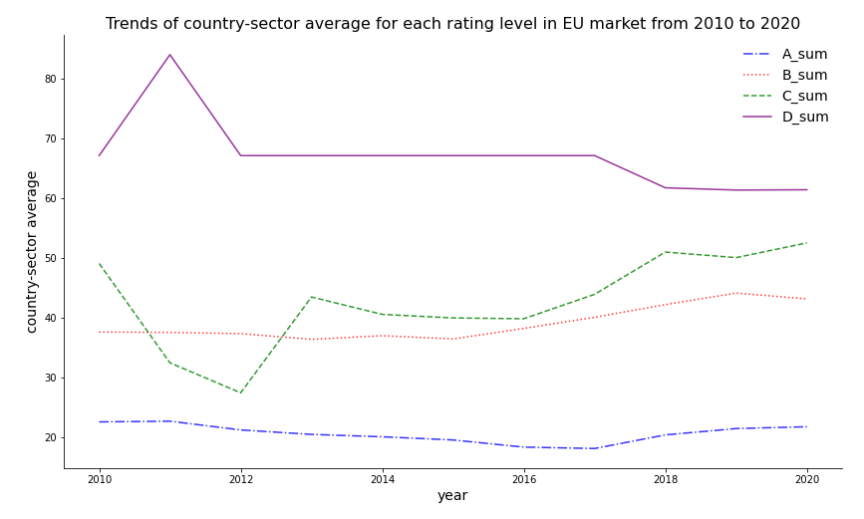
EU Market Country-sector Average Trend
Similar as U.S. market, higher rating level with lower country-sector average
Lower rating (C and D) have considerable fluctuation
Notes:
Europe Country-sector Average trend from 2010 to 2020

Slide 28
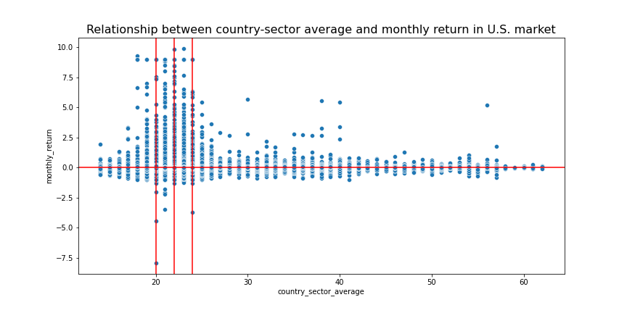
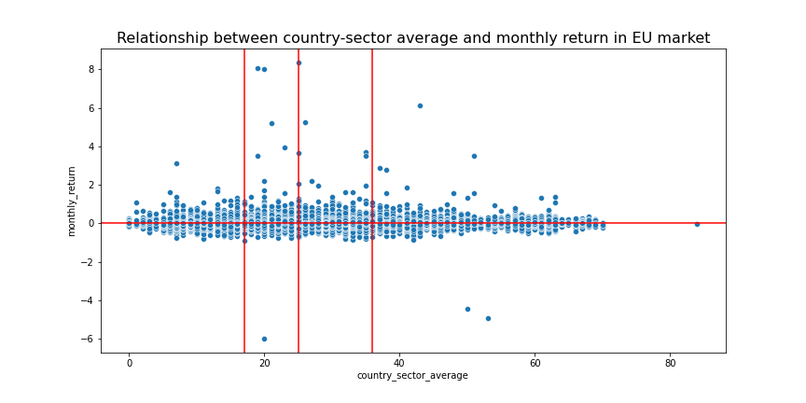
U.S. Market Country-sector Average & Monthly return
Country-sector average (US)
20% quantile is around 20
50% quantile is around 22
80% quantile is around 24
Country-sector average (EU):
20% quantile is around 17
50% quantile is around 25
80% quantile is around 36
Notes:
Relationship of country-sector average and monthly return between U.S. and Europe market.
The distribution of U.S. country-sector average is more concentrated than the Europe market

Slide 29
Data Modeling

Slide 30
EGMB Factor
Approach
- Using .5 quantile of ESG score to distinguish the good ESG (GESG) company and poor/bad ESG (BESG) company (quantile based on the EDA result)
Formula
Monthly EGMB (ESG Good minus Bad) factor =
GESG returns - BESG returns

Slide 31
Portfolio Selection
Select the portfolios based on company size and operating profit for the US and EU market
Size axis
Big weak
Big neutral
Big robust
Op. Profit​ axis
Small weak
Small neutral
Small robust
Notes:
- 6 portfolios based on size and operating profits metrics are selected. The excess returns are gathered from Ken French website.

Slide 32
OLS(Ordinary Least Squares) Regression
Formula:
Portfolio excess return ~ Market + HML + SMB+ EGMB
Values of interest:
Our focus - t-stats and p-value of EGMB
Future focus - Beta coefficient of EGMB

Slide 33
Output Comparisons

Slide 34
ESG Factor Significance in EU and in US
A
 | Β_{EGMB} in US (t-value) | Β_{EGMB} in EU (t-value)
Small Weak | 0.01 (0.50) | 0.02 (1.78)
Small Neutral | -0.01 (-1.304) | -0.01 (-1.11)
Small Robust | -0.02 (-2.01) | -0.03 (-1.85)
Big Weak | 0.01 (0.48) | 0.02 (0.77)
Big Neutral | -0.01 (-1.59) | 0.00 (0.26)
Big Robust | 0.00 (0.25) | -0.01 (1.09)
ESG factors, on average, are more significant in EU than in US
Small Robust Portfolio shows good significance for ESG in both markets
Aggregate
abs(t-value)
1.02
1.14

Slide 35
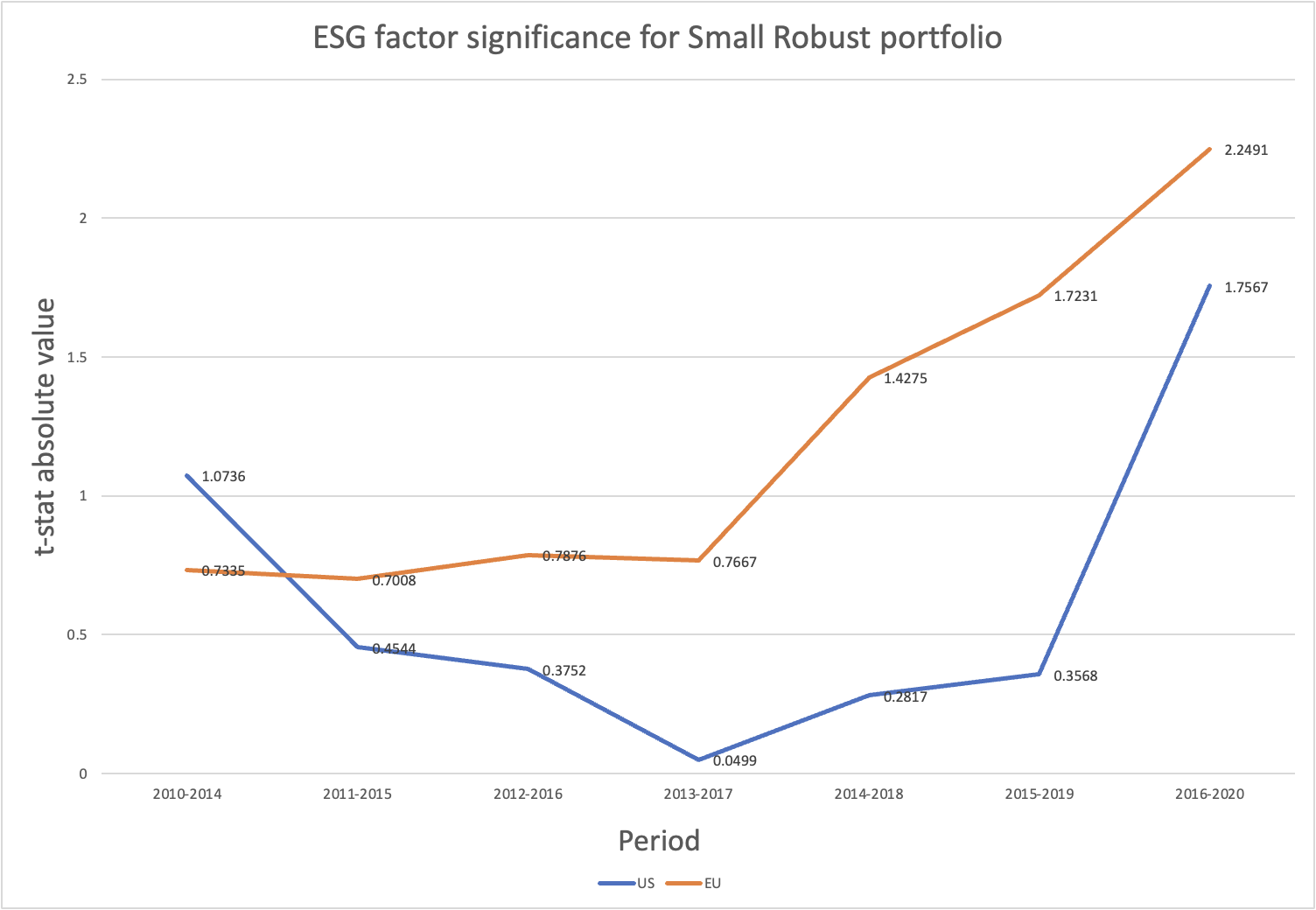
Comparing Small Robust Portfolio over Time
B
The x-axis represents the time series periods starting from 2010 to 2020
The y-axis represents the absolute value of t-stats which is the measure of significance
The graph shows that significance of ESG factor is steadily growing over time

Slide 36
Next Steps and Applications

Slide 37
Next Steps
Second step of Fama McBeth model.
Regress all asset returns for each of T time periods against the previously estimated betas to determine the risk premium for each factor. R_{i} − R_{f} = α_{i} + β₁*(R_{M} − R_{f}) + β₂*SMB + β₃*HML + β₄*EGMB + ϵ_{i}
Test different types of ESG factors
We tried "good-bad" ESG factor, but it would be useful to construct and test other different ESG factors, like "growing risk" factor, or factors that are separate for E, S and G.
"Tune" each ESG factor
For example, we picked 50% percentile as a threshold between "good" and "bad" ESG companies, but other thresholds may be considered
Correlation between ESG factors and existing factors like HML, etc.
Measure the sensitivity of factors' coefficients after the introduction of ESG factor.

Slide 38


Applications
To construct investment strategies
Finding more statistically significant factors will allow creating factor replicating portfolios
To construct trading strategies with ESG signals
ESG news effects tend to average around 2 months. There is a potential to develop a trading strategy based on moving average of ESG investment scores with new incidents changing the score in real-time.

Slide 39

Key Takeaways
A
Exposure to ESG is more significant in Europe then in US.
B
The significance of ESG factor exposure increases steadily over time.
ESG factor exposure most significant for "small robust" portfolio.
C
Higher ESG rated companies had more companies with higher returns, but this could be attributed to the imbalance in the data.​
Limitations:
RepRisk dataset is good for high level inferences, but a dataset with more granular ESG rating data required for to create investments strategies.

Slide 40
Appendix

Slide 41
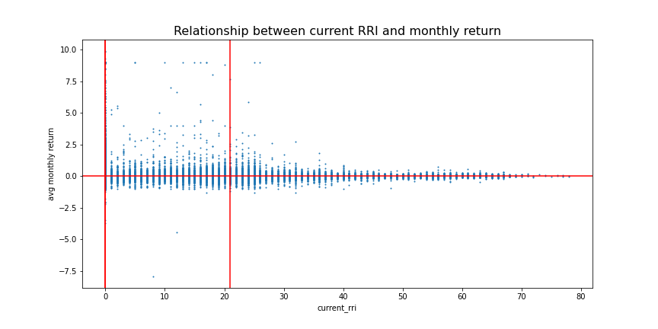
Unbalanced Sample
Median is 0
More than 50% of the companies in our dataset have 0 RepRisk rating.
Notes:
The Current RRI denotes the current level of media and stakeholder attention of a company related to ESG issues.

Slide 42
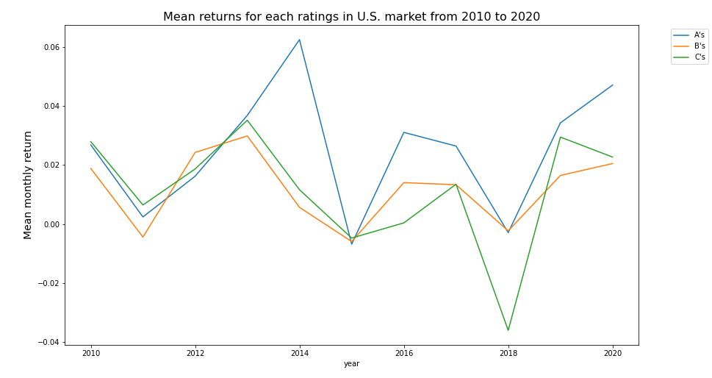
U.S. Market Monthly Return Trend
Small Inconsistency in samples between Years, which indicated that

Slide 43
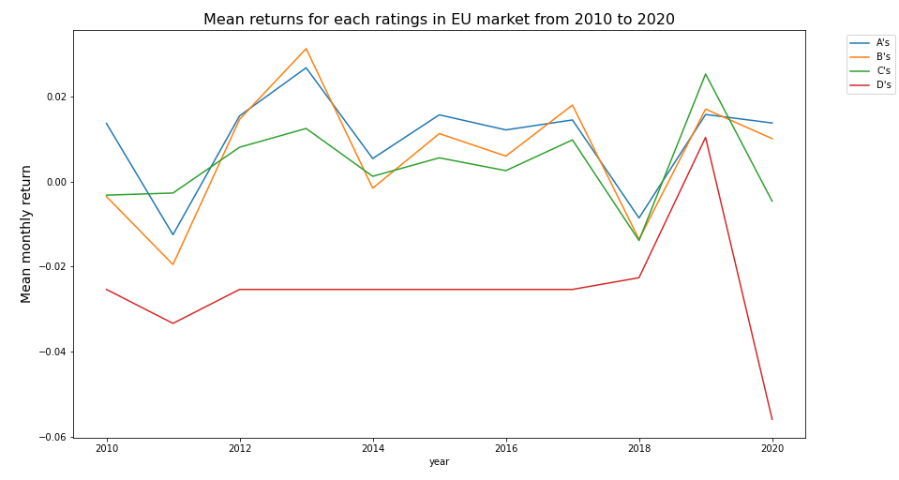
EU Market Monthly Return Trend

Slide 44
US Market Comparison
A
 | Constant _{(t-value)} | Β_{mrt} _{(t-value)} | Β_{SMB} _{(t-value)} | Β_{HML} _{(t-value)} | Β_{EGMB} _{(t-value)}
Small Weak | -0.15 (-1.50) | 1.05 (41.76) | 1.08 (26.97) | 0.04 (1.16) | 0.01 (0.50)
Small Neutral | 0.17 (2.11) | 0.91 (42.70) | 0.86 (25.55) | 0.38 (13.08) | -0.01 (-1.304)
Small Robust | -0.04 (-0.29) | 1.12 (32.25) | 0.88 (16.06) | 0.31 (6.65) | -0.02 (-2.01)
Big Weak | -0.19 (-1.58) | 1.09 (35.30) | 0.14 (2.88) | 0.16 (3.75) | 0.01 (0.48)
Big Neutral | 0.05 (0.82) | 0.97 (66.20) | -0.06 (-2.48) | 0.11 (5.54) | -0.01 (-1.59)
Big Robust | 0.05 (0.80) | 0.99 (63.77) | -0.16 (-6.35) | -0.15 (-7.19) | 0.00 (0.25)

Slide 45
EU Market Comparison
A
 | Constant _{(t-value)} | Β_{mrt} _{(t-value)} | Β_{SMB} _{(t-value)} | Β_{HML} _{(t-value)} | Β_{EGMB} _{(t-value)}
Small Weak | -0.17 (-3.32) | 0.99 (67.81) | 0.83 (29.45) | 0.23 (9.37) | 0.02 (1.78)
Small Neutral | 0.12 (3.11) | 1.00 (86.00) | 0.91 (40.94) | 0.02 (0.98) | -0.01 (-1.11)
Small Robust | 0.27 (3.70) | 1.01 (48.51) | 0.93 (23.23) | -0.05 (-1.36) | -0.03 (-1.85)
Big Weak | -0.01 (-0.13) | 1.04 (39.82) | 0.00 (-0.00) | 0.48 (11.24) | 0.02 (0.77)
Big Neutral | 0.01 (0.12) | 1.02 (74.80) | -0.13 (-4.84) | -0.12 (-5.11) | 0.00 (0.26)
Big Robust | -0.00 (-0.08) | 0.96 (64.29) | -0.15 (-5.34) | -0.27 (-10.94) | -0.01 (1.09)

